Slide 1
Project 3 – GigGuide.com
David Avellaneda
Ben Tokarczyk
Notes:
Idea for project came from a love of music and in particular live concerts.
I have seen a lot concerts over the years and use concerts as an anchor for vacations across America and sometimes out of the country.
I had an idea about mapping out a particular bands tour route which would help decide if I wanted to visit a particular location.
I Googled to see if Ticketmaster had an API and it did and the documentation was very through.

Slide 2
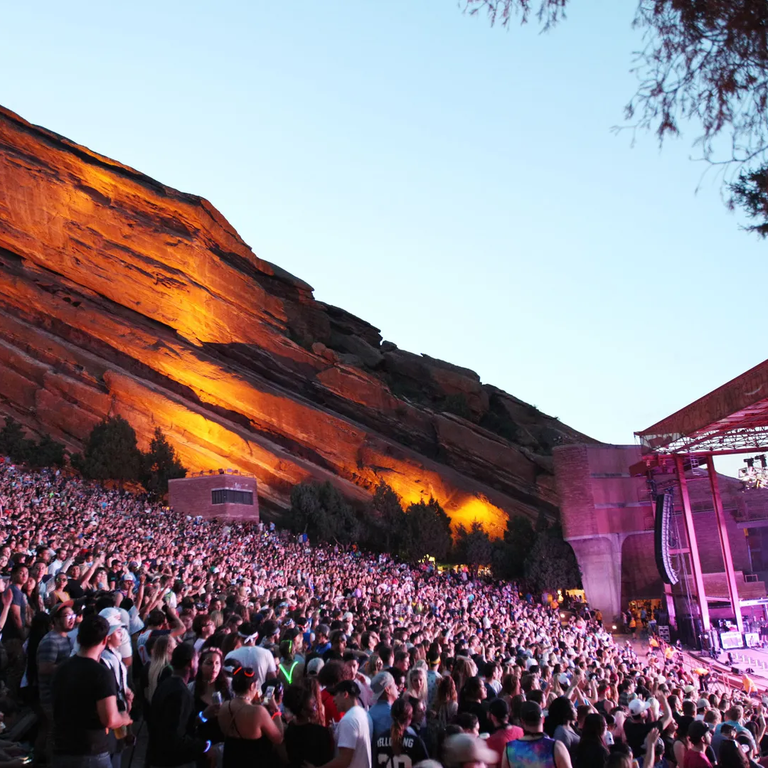
Agenda
Data Wrangling
Data Visualization
Lessons Learned

Slide 3
Data Wrangling
Utilizing MongoDB for Unstructured Data

Slide 4
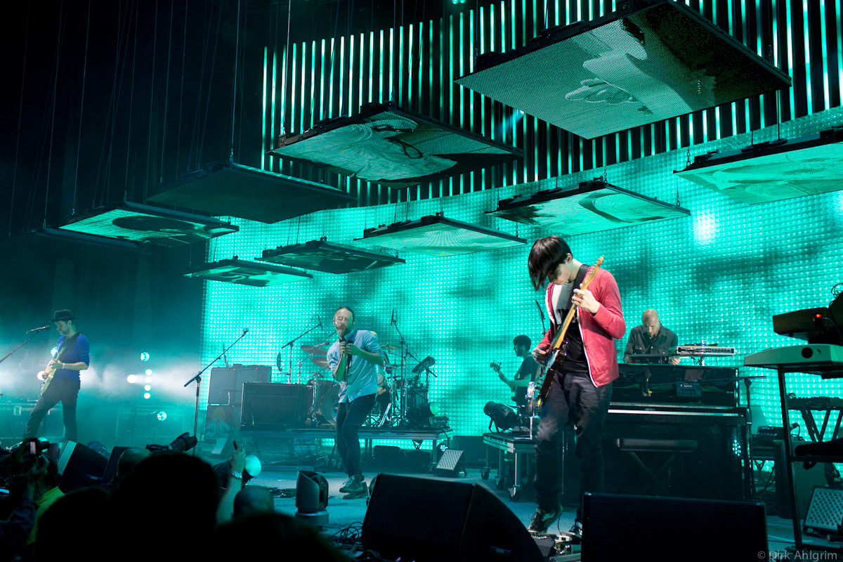
MongoDB Collections and Documents
Events
Single event on date/venue with multiple artist
Attractions
Single artist/event with date/venue information
Tour Run
Individual artist with multiple dates and venues
Notes:
Chose MongoDB because output was already in layered JSON
Had to loop through the API with 2 nest loops for the marketID which and pages, since there were limits on what could be pulled.
JSON was originally large with lots of data that wasn’t required, cleaned out data before loading into MongoDB and my events collection,
Cleaned up events collection to create attractions collection
From Attractions I used aggregation methods to create the Tour Run collection

Slide 5
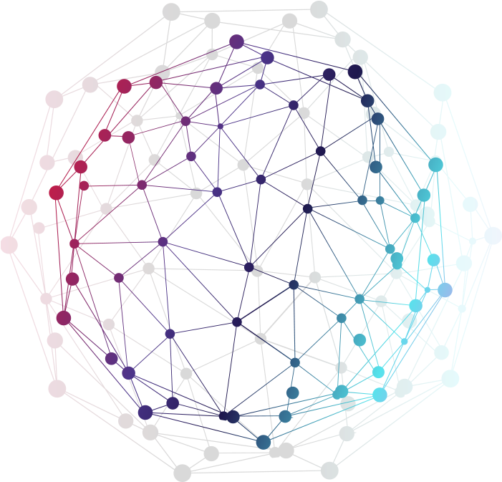
Data Visualizations
Enhancing your presentation

Slide 6

Mapping, list Generation and gifs
Using a new library, we were able to create the Bar Chart Race within Python to show how many concerts were happening based on genre through our chosen time period
Cluster mapping techniques learnt in class were utilized in our second map to showcase concerts happening in various locations across the united states
Creating dropdown and event handler to add layers to map drawing out the tour route of selected artist

Slide 7

Lessons Learned
That’s why it’s called learning…

Slide 8
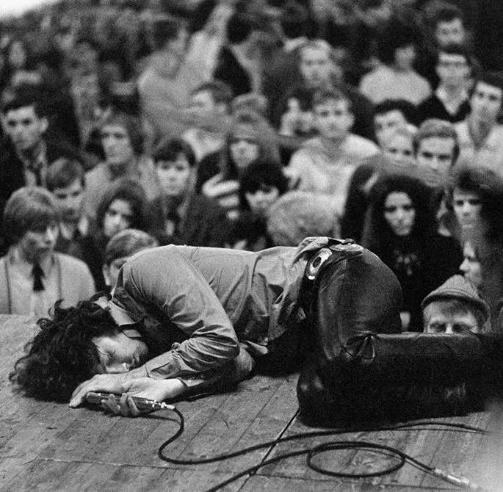
Setbacks and bad assumptions
Adding a delay timer on your API call worrying it might fail cost hours
Don’t expect data to be perfect
Trying to coordinate different parts of the project
Notes:
Understanding instructions
Sleep Timer
Fixing data in different countries

Slide 9
Thank you
Ben Tokarczyk
David Avellaneda

